Slide 1






Optimus Syria
Management Team
Vertical Model
In this form the poster has been divided on two vertical parts, each part contains different context depend on the team.
Please don’t change this area, it is common for all teams except the name of the team
This red line is only to explanation please don’t use it in your poster
5 MW
Rated power
Hub Height
Area 1
Area 2
Please don’t change the frame, for shapes, color and thickness it common for all teams.
Please don’t change this area, it is common for all teams

Slide 2
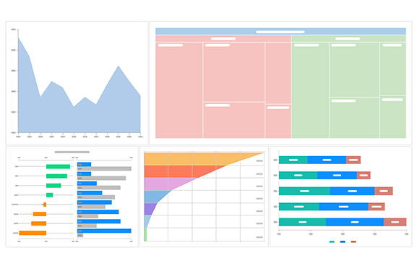
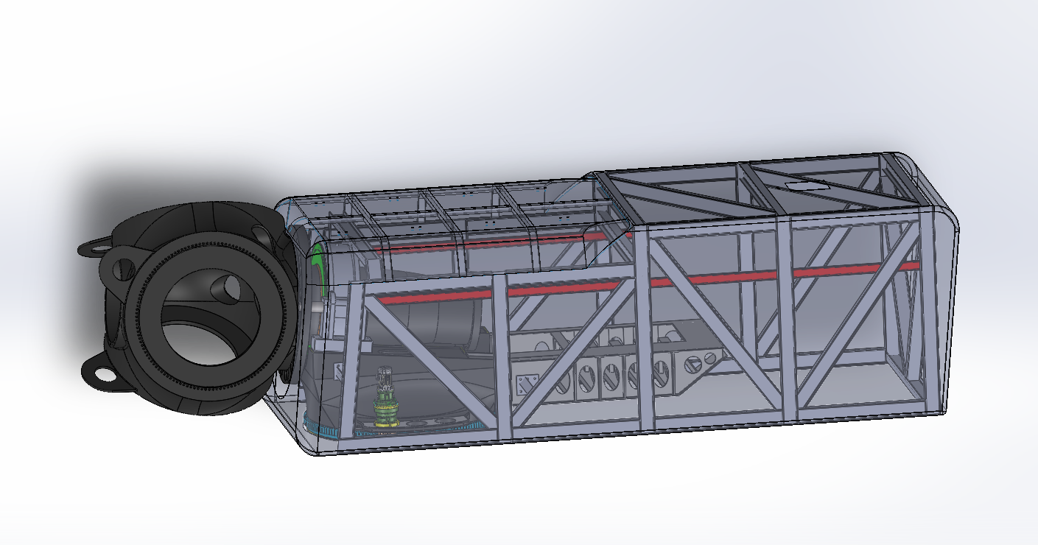
Optimus Syria
Management Team
Vertical Model
In this form the poster has been divided on two vertical parts, each part contains different context depend on the team.
Section Title
Please use this color, font and size.
For explanations, please use bullet points for the following reasons:
Increases scannability for viewers passing by.
Reduces wall of text fatigue by providing visual breaks.
Improves readability from a distance (3–5 feet).
Highlights key findings and main takeaways quickly.
Organizes complex information into digestible chunks.
Creates white space, making the layout look cleaner and more professional.
Color of texts and section titles
5 MW
For colors, please use dark blue for the following reasons:
Projects professionalism and a (serious) tone, often used in academic, corporate, or healthcare posters.
Provides high contrast against light backgrounds (white), ensuring text is easy to read from a distance.
Reduces eye strain compared to pure black text, as the (cool) undertones are less harsh on the eyes in bright exhibition halls.
Promotes a sense of calm and focus, helping viewers absorb information without feeling overwhelmed or (shouted at).
Please void of using Red color, it has been used here only to explain the template.
Rated power
Hub Height
Shapes or Icons & Charts or Graphs
For visualizations, please use shapes or charts to make the data much easier to be read, for the following reasons:
Simplifies data: Converts complex numbers into easy-to-read trends.
Speeds up comprehension: Allows viewers to grasp results in seconds.
Guides the eye: Uses arrows and lines to create a logical flow.
Saves space: Replaces repetitive words with intuitive icons.
CAD Model
For design, please use CAD model to make the design much easier to be understand, for the following reasons:
Realistic visualization: Provides clear 3D views of complex parts that are difficult to imagine.
Simplifies complexity: Uses exploded or cross-section views to explain how internal mechanisms work.
Instant engagement: Acts as a high-impact visual "hook" that draws viewers in from a distance.

Slide 3
Optimus Syria
Management Team
Horizontal Model
In this form the poster has been divided on (two or three) horizontal parts, each part contains different context depend on the team.
Area 1
Please don’t change this area, it is common for all teams except the name of the team
5 MW
Rated power
Hub Height
This red line is only to explanation please don’t use it in your poster
Area 2
Please don’t change the frame, for shapes, color and thickness it common for all teams.
Area 3
Please don’t change this area, it is common for all teams

Slide 4

Optimus Syria
Team Name
Horizontal Model
In this form the poster has been divided on (two or three) horizontal parts, each part contains different context depend on the team.
Section Title
Specifications with table
For explanations, please use bullet points for the following reasons:
Increases scannability for viewers passing by.
Reduces wall of text fatigue by providing visual breaks.
Improves readability from a distance (3–5 feet).
Highlights key findings and main takeaways quickly.
Organizes complex information into digestible chunks.
Creates white space, making the layout look cleaner and more professional.
5 MW
Rated power
Hub Height
Shapes or Icons & Charts or Graphs
For visualizations, please use shapes or charts to make the data much easier to be read, for the following reasons:
Simplifies data: Converts complex numbers into easy-to-read trends.
Speeds up comprehension: Allows viewers to grasp results in seconds.
Guides the eye: Uses arrows and lines to create a logical flow.
Saves space: Replaces repetitive words with intuitive icons.
CAD Model
For design, please use CAD model to make the design much easier to be understand, for the following reasons:
Realistic visualization: Provides clear 3D views of complex parts that are difficult to imagine.
Simplifies complexity: Uses exploded or cross-section views to explain how internal mechanisms work.
Instant engagement: Acts as a high-impact visual "hook" that draws viewers in from a distance.

Slide 5
Optimus Syria
Team Name
Mixed Model
In this form the poster consists of both vertical and horizontal parts, each part contains different context depend on the team.
Please don’t change this area, it is common for all teams except the name of the team
This red line is only to explanation please don’t use it in your poster
5 MW
Rated power
Hub Height
Area 1
Area 2
Please don’t change the frame, for shapes, color and thickness it common for all teams.
Area 3
Please don’t change this area, it is common for all teams

Slide 6
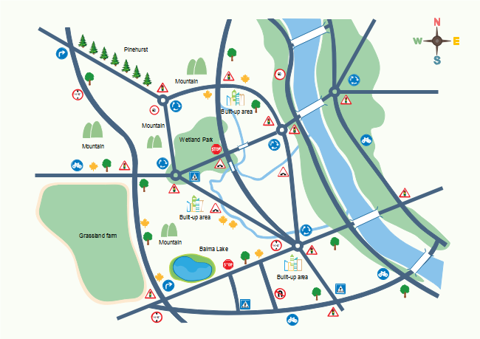
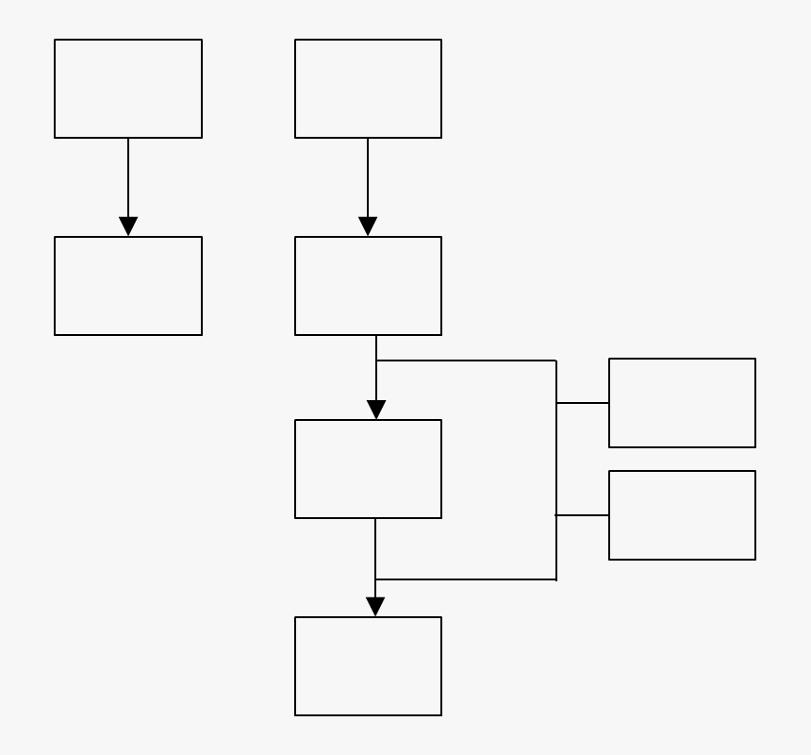
Optimus Syria
Management Team
Horizontal Model
In this form the poster has been divided on (two or three) horizontal parts, each part contains different context depend on the team.
Section Title
Shapes or Icons & Charts or Graphs
5 MW
For visualizations, please use shapes or charts to make the data much easier to be read, for the following reasons:
Simplifies data: Converts complex numbers into easy-to-read trends.
Speeds up comprehension: Allows viewers to grasp results in seconds.
Guides the eye: Uses arrows and lines to create a logical flow.
Saves space: Replaces repetitive words with intuitive icons.
For explanations, please use bullet points for the following reasons:
Increases scannability for viewers passing by.
Reduces wall of text fatigue by providing visual breaks.
Improves readability from a distance (3–5 feet).
Highlights key findings and main takeaways quickly.
Organizes complex information into digestible chunks.
Creates white space, making the layout look cleaner and more professional.
Rated power
Hub Height
Map or Diagram or Picture
CAD Model

Slide 7

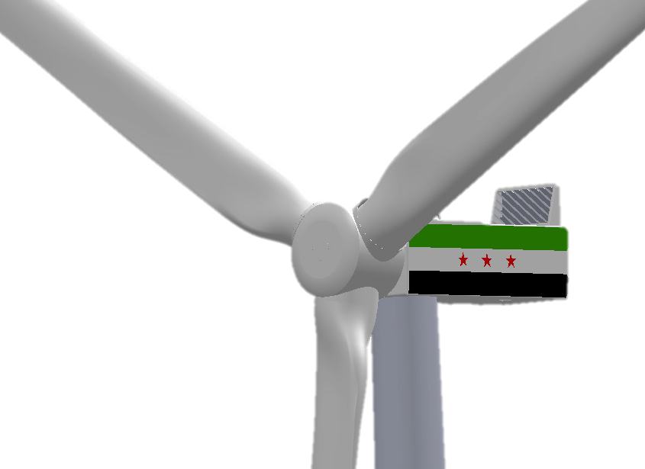
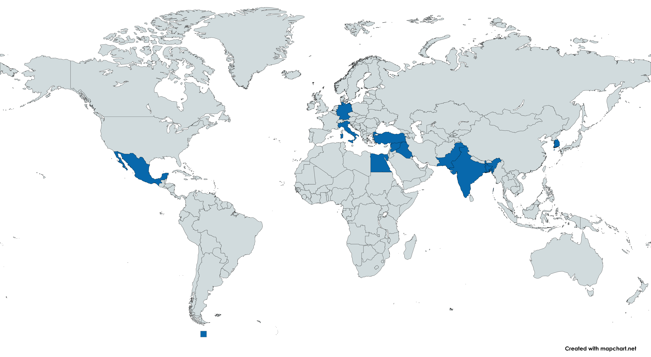









Optimus Syria
Management Team
Wind Energy Convertor Optimus Syria
System Configuration
Joint German Syrian initiative to develop the state of art wind turbine.
Engineered for Syrian environmental and operational condition.
Technical Data:
Rated power: 5 MW
Rotor Diameter: 160 m
Hub height: 100 m
Concept: 3 Point Suspension
Transmission type: Geared
Generator type: DFIG
Primary Control: Feedback Control
Advanced Control: Lidar Assisted Control
Hub Height
Team Management Structure
Steering Committee
Merging global engineering skills with cultural insights.
System Integrator
Project Manager
Deputy of Project Manager
Uniting 49 students from 11 countries.
Load & Dynamic
Project Development
Rotor Blade Aerodynamic
Feedback + Lidar Assisted Control
Electrical Drivetrain
Rotor Blade Structure
Rotor Hub Pitch System
Grid Code Development
Gearbox, Brake, Coupling
Rotor Bearing
Tower
Machine Bed Yaw
Mexico
Italy
Germany
Egypt
Turkey
Kurdistan
Storage
Foundation
Syria
India
Bangladesh
Pakistan
South Korea
Supporters & Suppliers

